Slide 1





Seeds of Growth
Kick-off meeting at the 14th LLD Forum in Luxembourg
“Funded by the European Union. Views and opinions expressed are those of the author(s) only and do not necessarily reflect those of the European Union or the Dům zahraniční spolupráce (DZS). Neither the European Union nor the granting authority can be held responsible for them.”

Slide 2
Objective and outcomes
The project "Seeds of Growth: Strengthening Community Seed Banks and Sustainable Seed-Saving Practices in Europe" aims to professionalize seed-saving practices and enhance the role of Community Seed Banks (CSBs) as a tool to conserve, promote the sustainable use of locally adapted and diverse seeds within the European’s agricultural and food system.
Expected Outcomes:
Capacity Building: Equip seed librarians, CSB managers, farmers with knowledge & skills.
Knowledge Exchange: Facilitate collaboration & peer learning across EU.
Public Awareness: Highlight role of seed diversity in food sovereignty & climate resilience.
Education Impact: Integrate seed-saving into curricula through partner institutions.

Slide 3
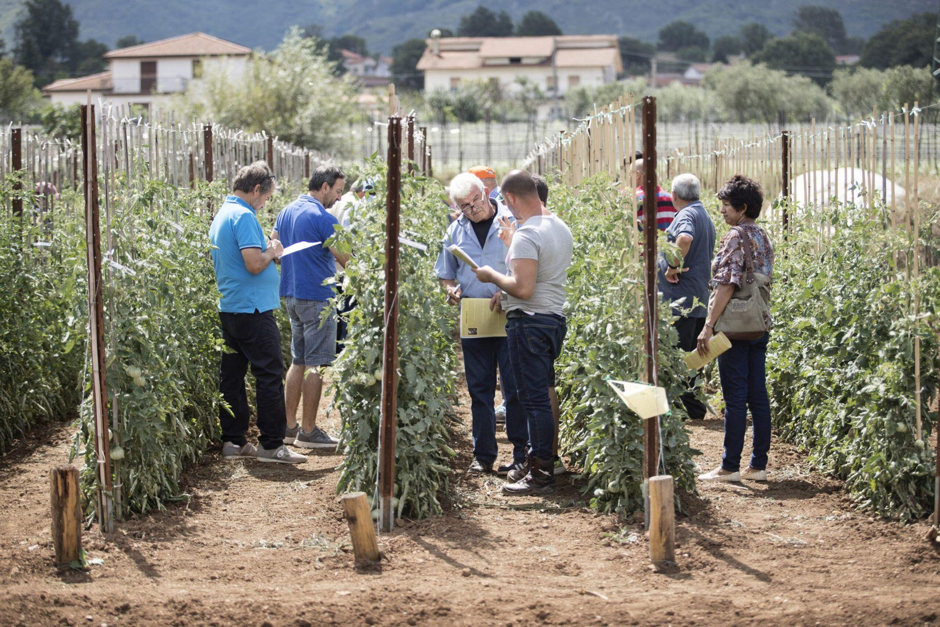
Target groups
Seed Librarians & CSB Managers – capacity building, networking.
Farmers (smallholders, organic, agroecological) – practical adoption of diverse seeds.
Educational Institutions & Researchers – curriculum integration, exchange with practitioners.
General Public – awareness activities, seed fairs, campaigns.

Slide 4
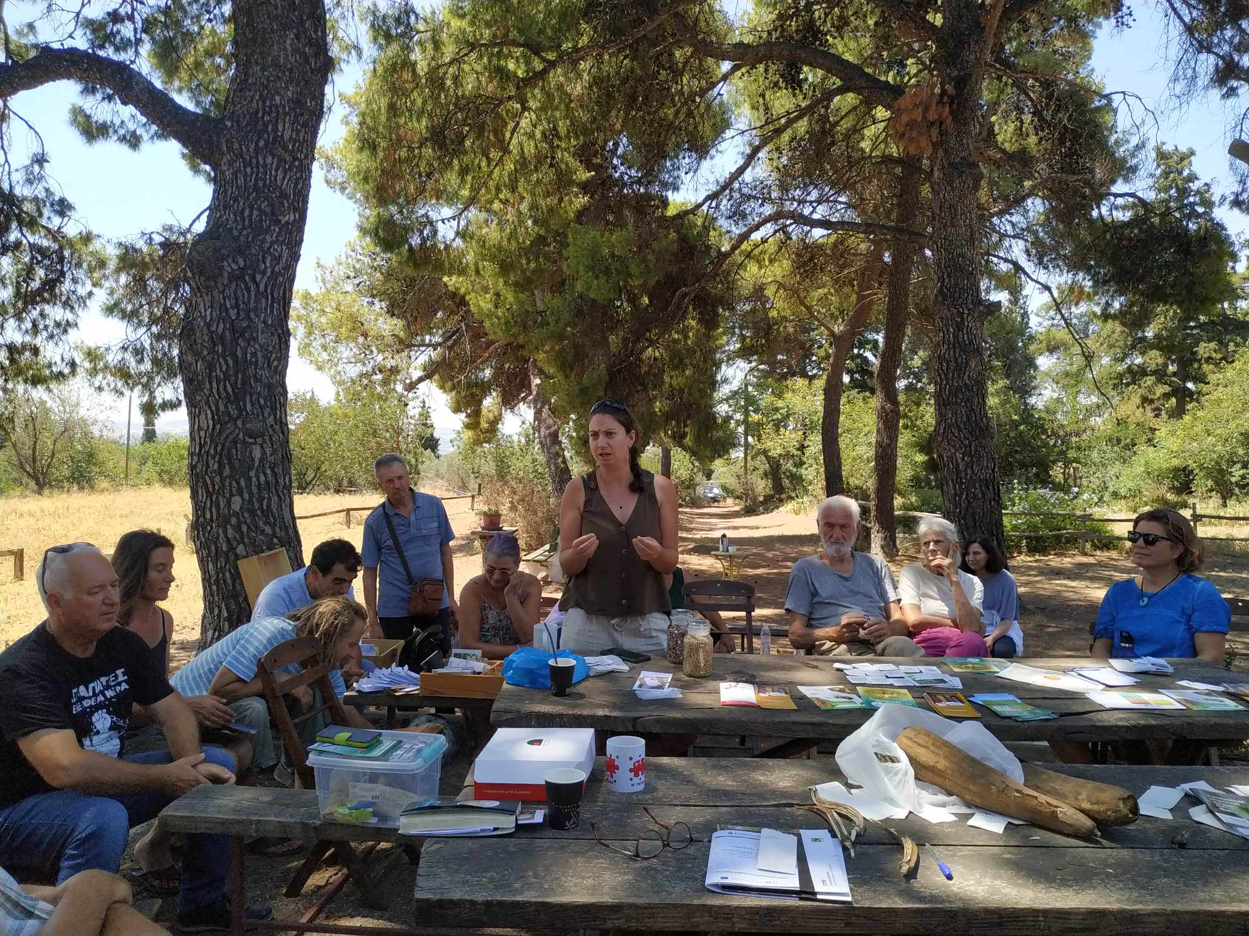
Activities 1/2
Kickoff & Coordination
Launch at LLD Forum 2025 (Luxembourg)
Internal Kickoff meeting (project staff)
Presentation to the LLD Forum participants.
Capacity Gap Analysis and Seed Knowledge Hub
Survey to identify needs of seed savers, farmers, CSBs.
Collection of resources & best practices.
Creation of online multilingual Seed Knowledge Hub on EC-LLD website.
How can you engage engage:
Participate in the survey and help us disseminating.
Share resources & materials to contribute to the Seed Knowledge Hub.

Slide 5
Activities 2/2
Community Seed Bank Labs (online)
With live interpretation & video materials integrated into the Seed Knowledge Hub.
Training modules: CSB governance, seed quality and conservation, policy frameworks.
Cross-country Visits (Luxembourg, Czech Republic)
Peer-to-peer learning and field visits (places available for 15 participants).
Dissemination & Multiplier Events
National seed fairs & awareness activities in CZ & LU and EU level events
How can you engage engage:
Attend webinars & training. Community Seed Bank Labs expected between January and April 2026.
Join field visits and events. Cross-country visits expected between April and November 2026.
Help us disseminate results and outputs of the project

Slide 6
Indicative Workplan
Activity |  | Sep | Oct | Nov | Dec | Jan | Feb | Mar | Apr | May | Jun | Jul | Aug | Sep | Oct | Nov | Dec
Kickoff Meeting at the 14th LLD Forum in Luxembourg
Capacity Gap Analysis and Resource Collection for the Development of Community Seed Banks
Community Seed Bank Labs – Training Series on CSB Management and Policy
Cross-Country Visits and Peer-to-Peer Learning for Strengthening Community Seed Banks and Innovation
Dissemination and National Multiplication Activities

Slide 7

Survey
Purpose:
Identify knowledge gaps, training needs, and barriers for farmers, seed savers, educators, and researchers in Europe.
Inform the design of training, peer learning, and the Seed Knowledge Hub.
Who can participate?
Farmers & seed savers
Community Seed Bank & seed library members
Educators & researchers
Students & interested citizens
The full content of the survey is available here. The survey will be translated in Czech and English and launched right after the Forum. We will share the link to all of you

Slide 8
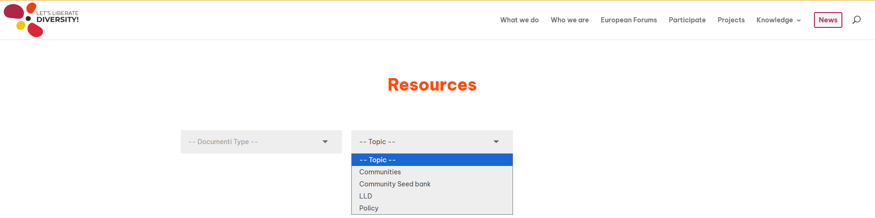
Seed Knowledge Hub
Open-access multilingual repository.
Manuals, training guides, case studies, policy briefs
Builds on materials from various projects (Dynaversity, DiverSeedPaths, LiveSeeding, etc) and organisations (CSOs, Academia, etc).
Long-term resource for practitioners, educators, policymakers.
We will reach out asking to share with us the material to compile the Seed Knowledge Hub!
It is going to be available at www.liberatediversity.org/resources before the end of the year.

Slide 9

Training and Field Exchanges
We are working on it, we will be in touch with more information on dates and details

Slide 10
Recap and next steps
Next Steps (Project staff):
Launch & disseminate the survey
Collect & compile resources for the Seed Knowledge Hub
Prepare training labs (early 2026)
Plan cross-country visits & national events (mid/late 2026)
How You Can Engage:
Share your expertise and needs via the survey
Access & contribute to the Seed Knowledge Hub
Take part in training webinars and national events
Join peer-to-peer exchanges during field visits
Amplify awareness through your networks & communities
We’ll follow up by email – let’s stay in touch! … and please complete the survey and indicate if you’d like to join our mailing list.

Slide 11
Our contacts
For any question or feedback do not hesitate to get in touch with us
Gabriele Maneo (EC-LLD!): gabriele.maneo@liberatediversity.org
Klára Hrdá (Seminkovna): info@seminkovna.cz
Frank Adams (SEED): frank.adams@education.lu
“Funded by the European Union. Views and opinions expressed are those of the author(s) only and do not necessarily reflect those of the European Union or the Dům zahraniční spolupráce (DZS). Neither the European Union nor the granting authority can be held responsible for them.”

